Slide 1
Speed–time graphs
Physics

Slide 2
Lesson Objective
By the end describe and graph:
Speed–time graphs

Slide 3
Review
Think Pair Share
Describe:
Distance–time graphs
Displacement–time graphs

Slide 4
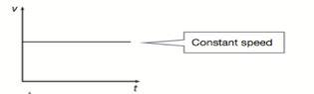
A speed–time graph shows how an object’s speed changes over time
An object’s speed may:
• be constant, as shown by a flat line

Slide 5
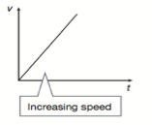
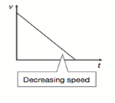
• Increasing, as shown by the graph rising upwards
• Decreasing, as shown by the graph falling downwards.

Slide 6
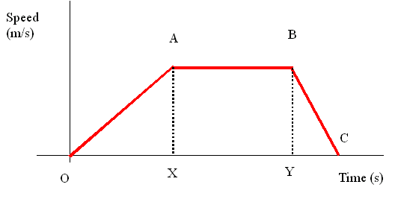
The gradient is equal to the acceleration, or how fast an object is changing it's speed
Describe what is happening to the speed of a dog as it chases a ball
Notes:
Starts stationary, increases its speed up to point A, then constant speed until point B, then rapidly slows down until stationary

Slide 7
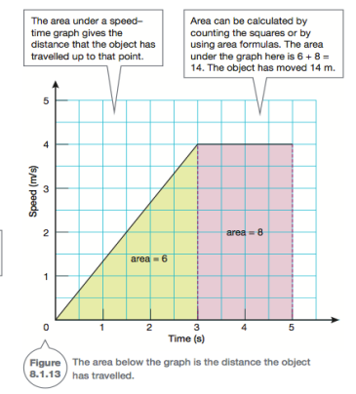
The area below a speed–time graph is equal to the distance the object has travelled up to a given point. Remember Distance = speed x time
2
1

Slide 8
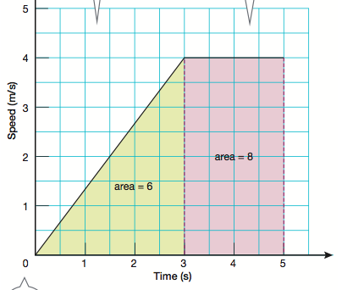
How far has this car travelled?
2
1
Notes:
Triangle = ½ base x height = 0.5*3*4 = 6m
Rectangle = base x height = 2*4 = 8m
Total = 6+8 = 14m

Slide 9
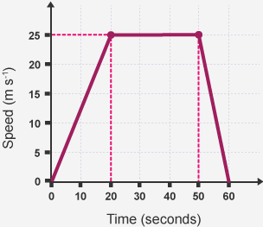
Calculate the total distance travelled.
Total distance = 1125m
Notes:
Distance = 0.5*20*25 = 250m
30*25=750m
0.5*10*25=125m
Total = 1125m

Slide 10
Calculate the acceleration in the first 20 seconds, and then again for time 50-60 seconds
Time 0-20
= 25/20
= 1.25m/s/s
Time 50-60
= -25/10
= -2.5m/s/s
Notes:
Time 0-20 seconds
= 25/20 = 1.25m/s/s
Time 50-60 seconds
=-25/10
=-2.5m/s/s (is negative as speed is decreasing)

Slide 11
NOW LETS WATCH A CAR CHASE!!

Slide 12
Recall
30 seconds think time
Describe:
Speed–time graphs

